Slide 1
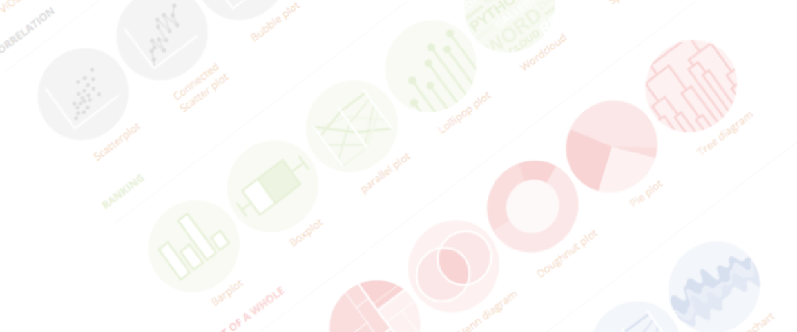
Introduction to data visualization
What, how, why, and more
Yan-holtz.com/teaching

Slide 2
What

Slide 3
A picture is worth a thousand words
Taking data, finding the good way to show it
Using picture to represent data
List of chart type
John snow map
Don’t have to be boring
Building chart -> Building infographiz -> building interactivity -> Dashboard -> story telling
Notes:
Dinéusorus

Slide 4
Looking for a chart ?
What you can do
What you should do
Caveats to avoid
How to
build it

Slide 5
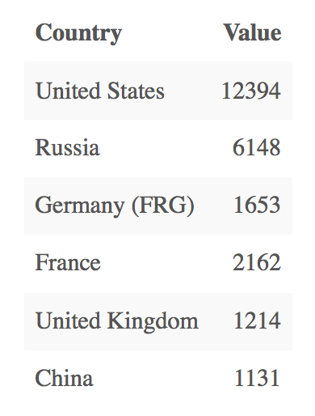
Who sells more weapons ?
?
Notes:
Very simple dataset,
-> What would you do ?
quantity of weapons exported by the top 50 largest exporters in 2017.
on the Stockholm International Peace Research Institute

Slide 6
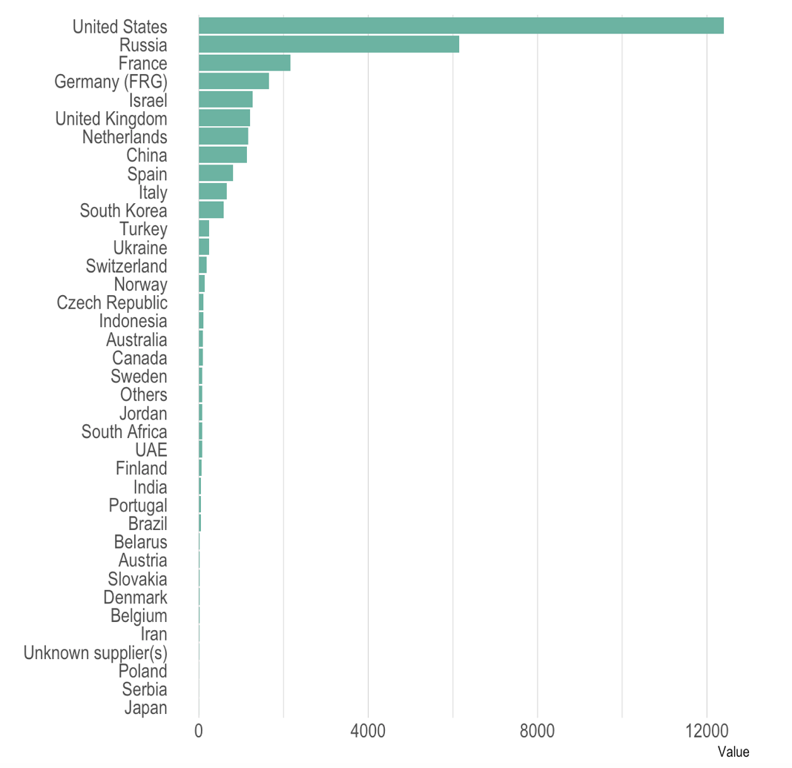
Who sells more weapons ?

Slide 7
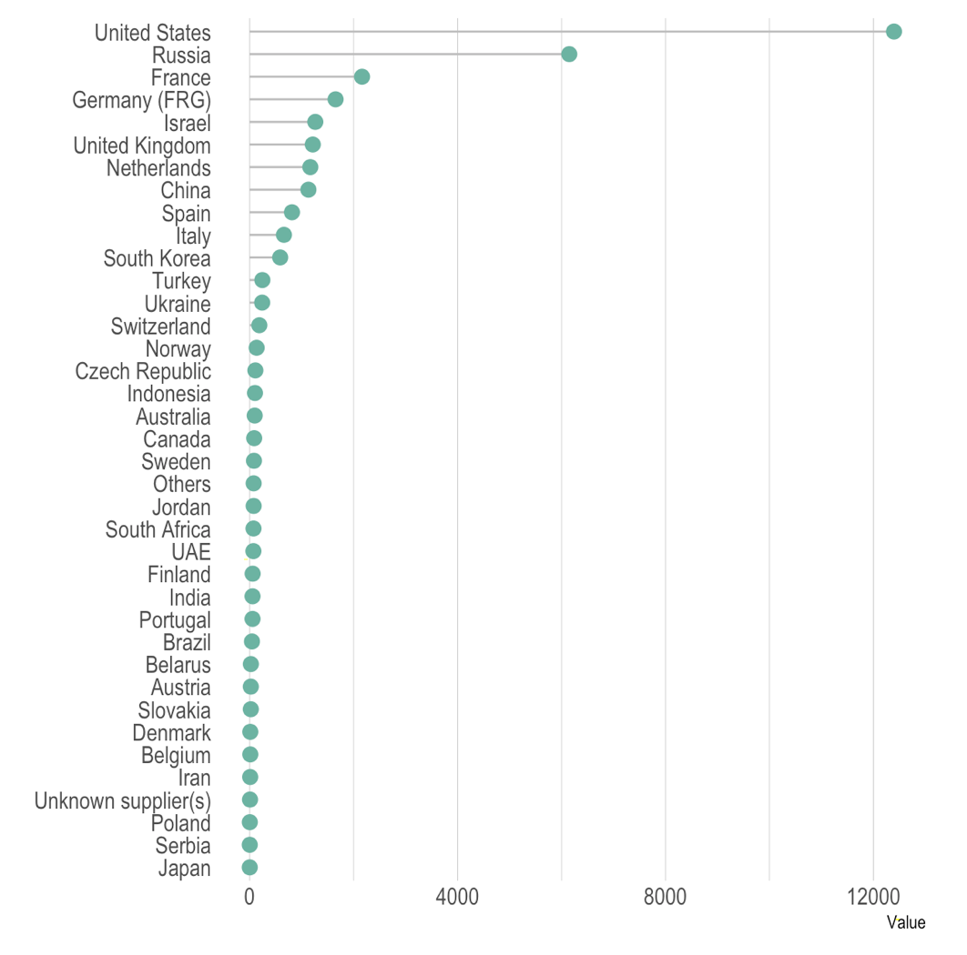
Who sells more weapons ?

Slide 8
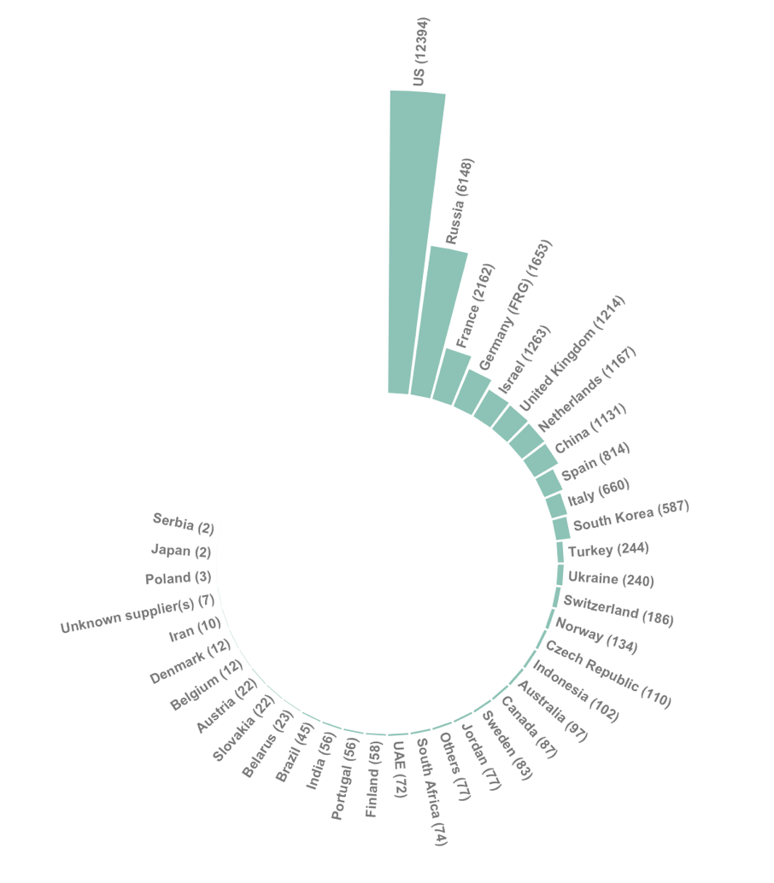
Who sells more weapons ?

Slide 9
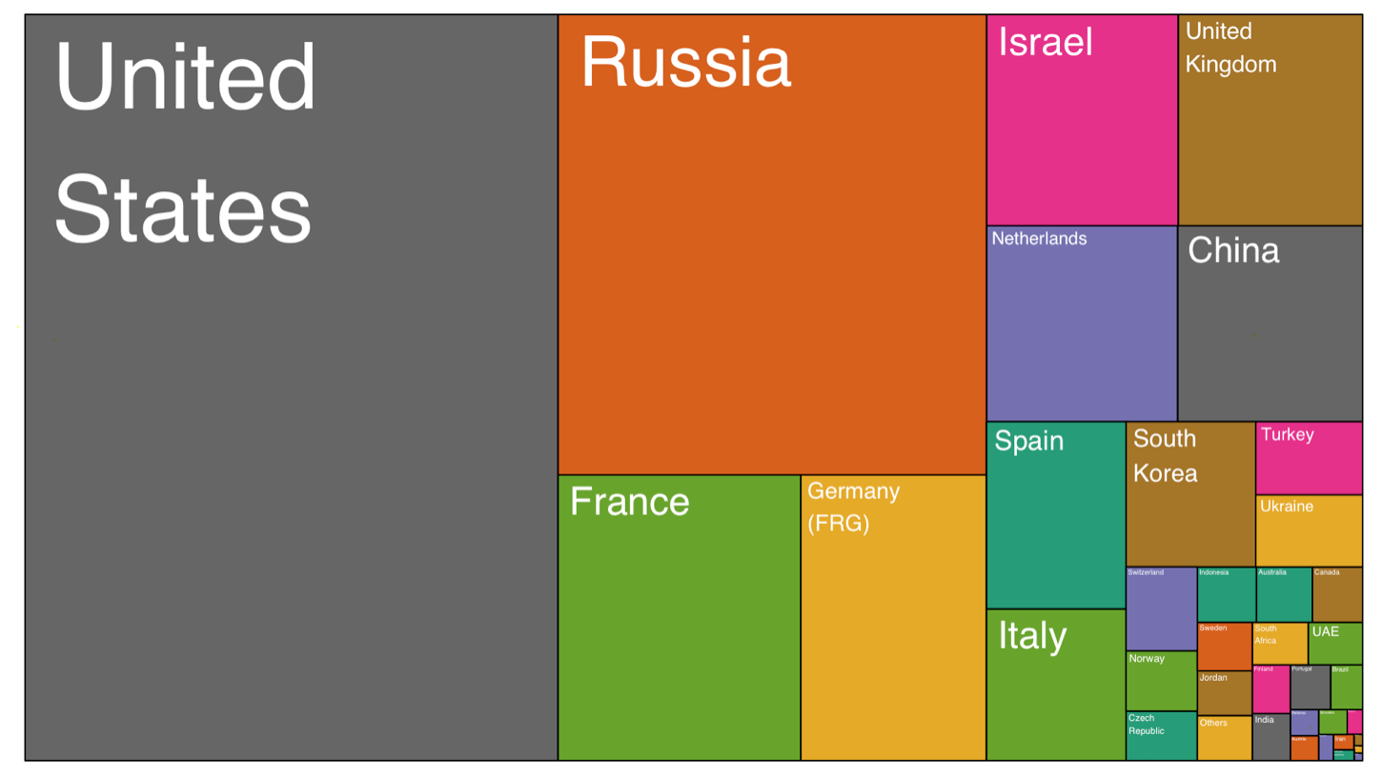
Who sells more weapons ?

Slide 10
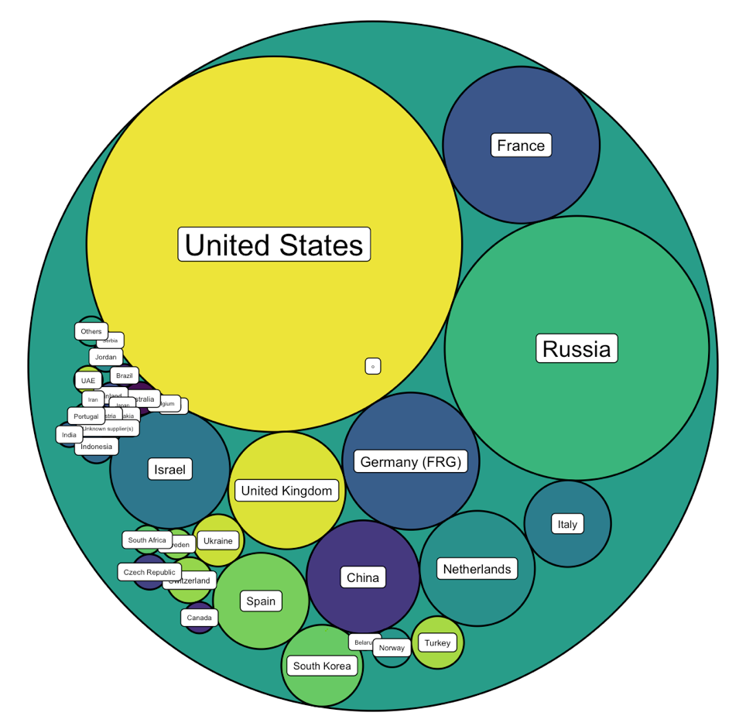
Who sells more weapons ?

Slide 11







Who sells more weapons ?

Slide 12
Eye catching / accurate
Question
Exploratory vs Explanatory
Chart Decision
Interactive or Static?
Who’s reading ?
Data itself

Slide 13
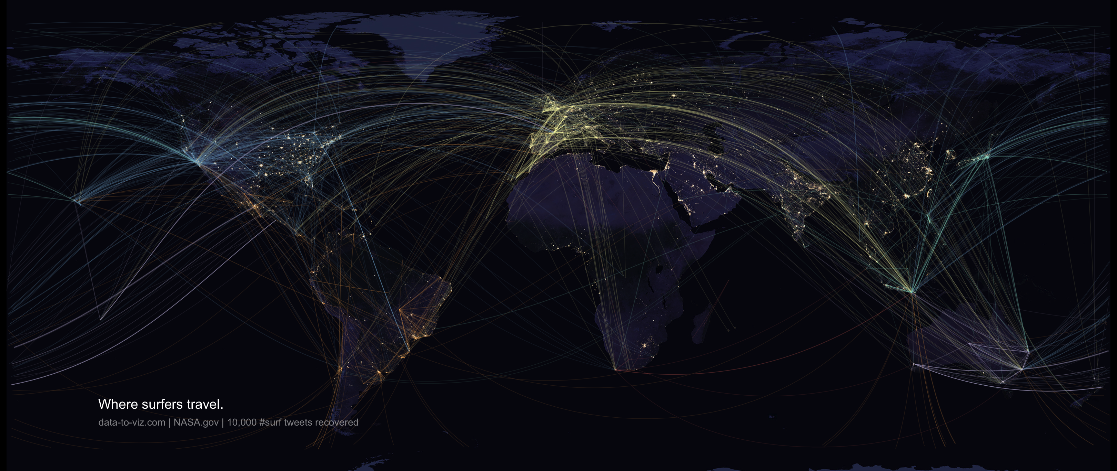

Slide 14
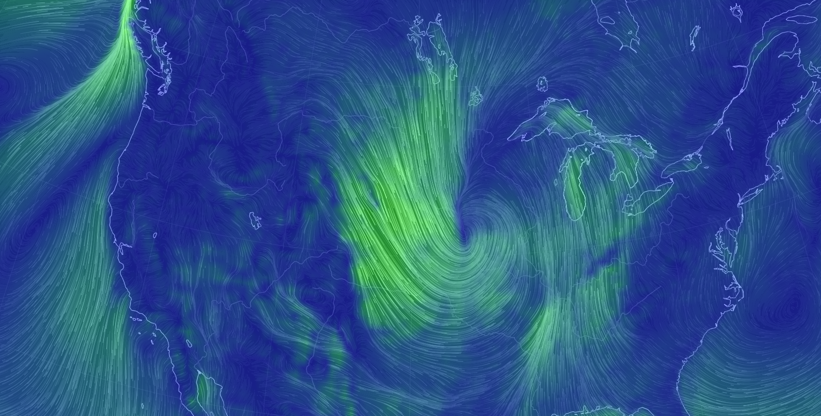
Notes:
Dinéusorus

Slide 15
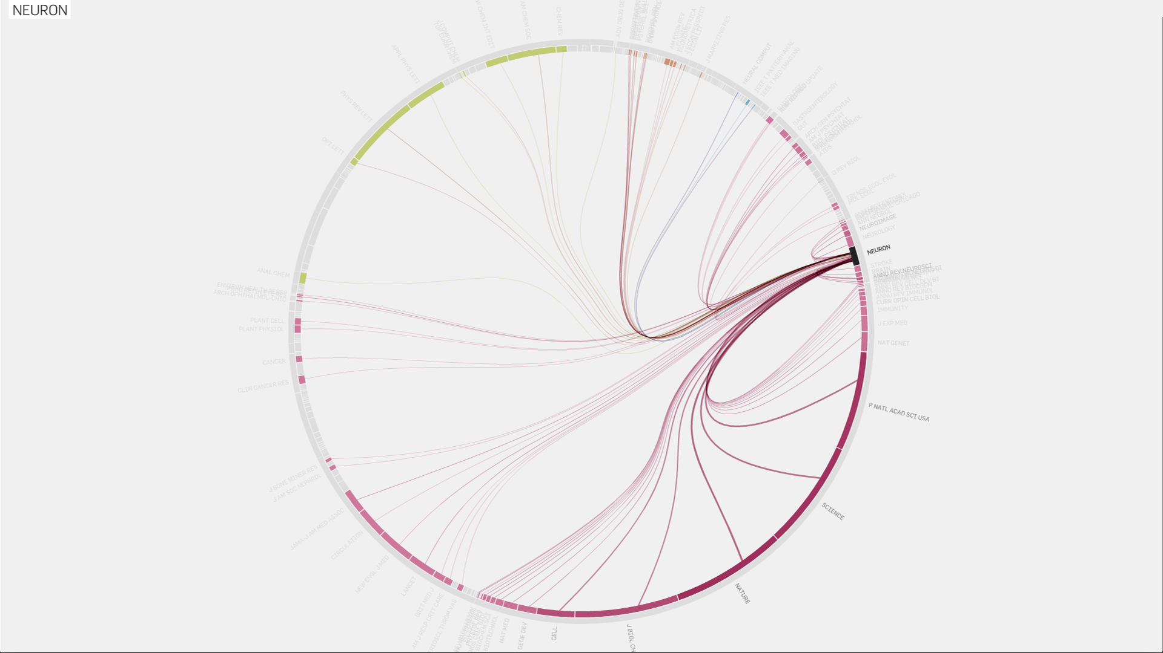
Truth-and-beauty.net
Notes:
Dinéusorus

Slide 16
Why

Slide 17
2/ Do you like Excel spreadsheet?
Can you understand them?
No, so you need to visualize it
Called the “picture superiority effect”
Notes:
Dinéusorus

Slide 18
OK, but you have summary statistics!
No, sumstat are dangerous
Notes:
Dinéusorus

Slide 19
Y = 3 + 0.5x
Cor = 0.8
Mean(x) = 9
Var(x) = 11
Mean(Y) = 7.5
Var(Y) = 4.1
Anscombe's quartet
Anscombe et al. 1973
Notes:
Dinéusorus

Slide 20
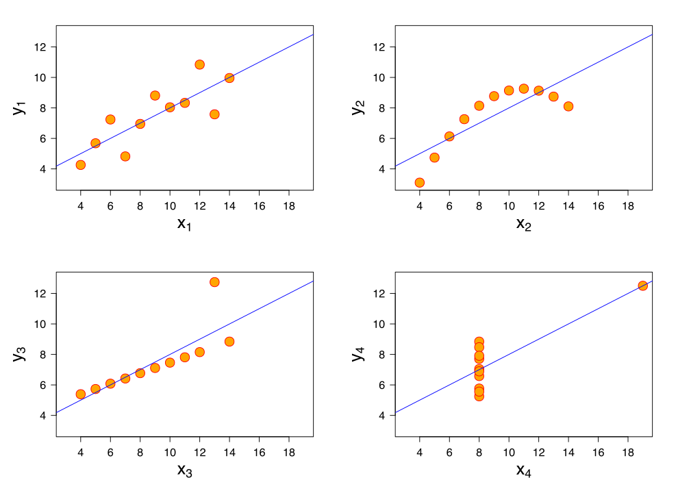
Y = 3 + 0.5x
Cor = 0.8
Mean(x) = 9
Var(x) = 11
Mean(Y) = 7.5
Var(Y) = 4.1
Plot your data
Anscombe's quartet
Anscombe et al. 1973
Notes:
Dinéusorus

Slide 21
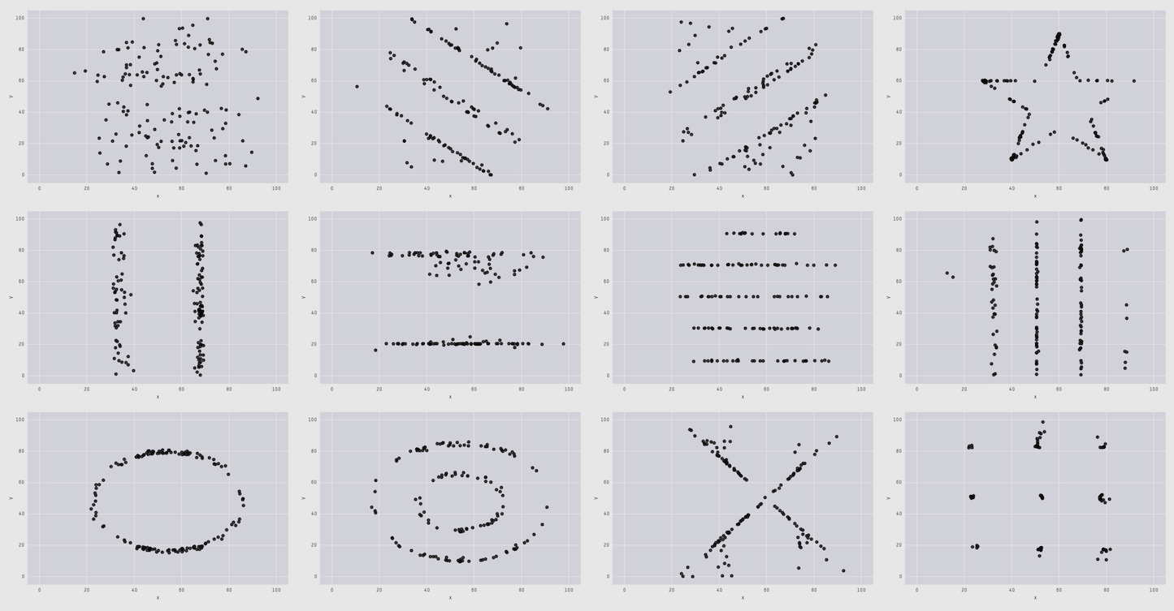
The Datasaurus Dozen
Cairo , 2017
Matejka & Fitzmaurice, 2017

Slide 22
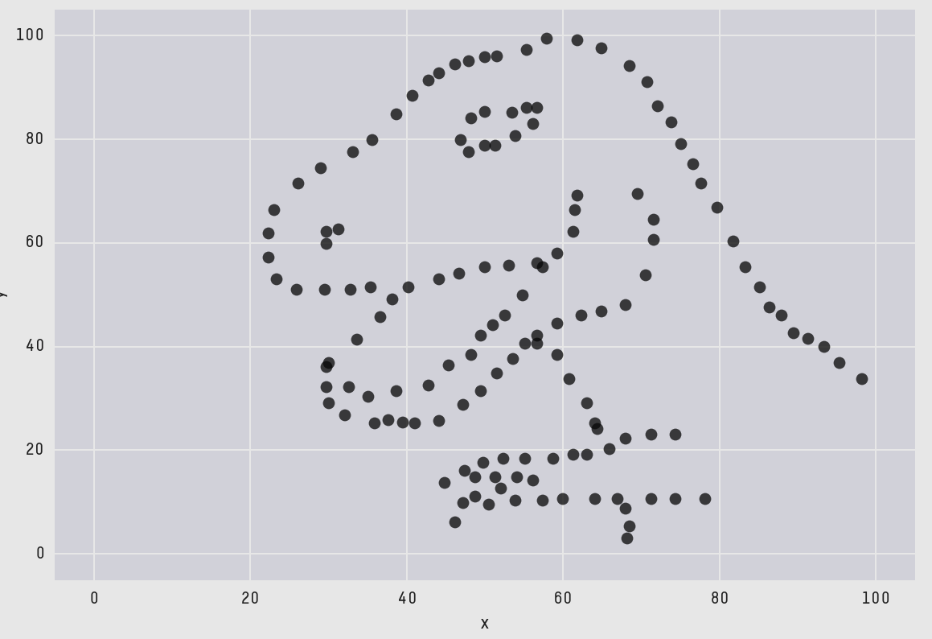
The Datasaurus Dozen
Cairo , 2017
Matejka & Fitzmaurice, 2017

Slide 23
So dataviz = Understand data, make decision = EXPLO
But not only, also nice way to communicate!
Communicate result = EXPLA
2/ Do you like Excel spreadsheet?
Can you understand them
Notes:
Dinéusorus

Slide 24
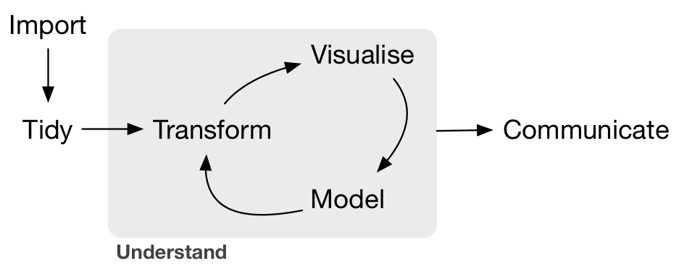
Notes:
Dinéusorus

Slide 25
How

Slide 26
See the chart maker directory by visualisingdata.com
Data Wrapper
R
Flourish
Python
Tableau
SAS
Jump
MatLab
Excel
QlikView
Julia
D3
Easy
Limited
Hard
Flexible
* Far from being exhaustive

Slide 27

See the chart maker directory by visualisingdata.com
Data Wrapper
R
Flourish
Python
Tableau
SAS
Jump
MatLab
Excel
QlikView
Julia
D3
Easy
Limited
Hard
Flexible
* Far from being exhaustive

Slide 28
Example:
Take a dataset
Explore it -> show explo graph
Make a visual one result is known
-> This is what you’re gonna do during the rest of the course
Notes:
Dinéusorus

Slide 29


R-graph-gallery.com
Python-graph-gallery.com
D3-graph-gallery.com
Notes:
Demo d3-graph gallery.com

Slide 30




Thanks
Yan.holtz.data@gmail.com
www.yan-holtz.com
Slides:
bit.ly/2SxJFlV
Cheat Sheet:
bit.ly/2AZySd9
@R_Graph_Gallery
github.com/holtzy
Pimp my rmd:
bit.ly/2QDX7Hz

